Slide 1


ICMS User Orientation Training
Infocomm Competency Management System (ICMS)
SECTION D: TRAINEE ENROLMENT
For Course Providers
Apr 2018

Slide 2
ICMS Trainee Enrolment: Content Page
Endorsed Course Providers (CP) are able to perform the following functions in ICMS:
    Create Trainee Enrolment Record
    Update Trainee Enrolment Record Details
    Search/View Trainee Enrolment Record

Slide 3
ICMS Trainee Enrolment
Trainee Enrolment Defined Window Period
  CP Approving Officer (AO) has the option to create the trainee enrolment record(s) in ICMS:
        30 calendar days before the course and/or examination start date OR
        Up to 5 calendar days from the course and/or examination start date.
Amend/Update trainee enrolment records
  CP AO is able to amend/update changes in the trainee enrolment records within the defined enrolment window period
Amend/Changes required after the enrolment window period
  Amendment requested by CP AO will be routed to IMDA for approval.

Slide 4
ICMS Trainee Enrolment
Please note that the course/exam start date reflected in the enrolment record
cannot be changed to an earlier date.
E.g. Initial Date in enrolment record: 10 Dec 2015
Cannot be changed to 9 Dec 2015 or earlier.
Reason(s) must be provided for such change and IMDA reserves the rights to
approve/reject the change request.

Slide 5
ICMS Trainee Enrolment: SkillsFuture, PSEA Credit Field
To submit SkillsFuture, Psea Credit claim amount at point of trainee enrolment
  Course Provider (CP) will need to submit the Skillsfuture/Psea Credit claim amount use to offset the course fee by eligible self-sponsored individual in ICMS
To note:
SkillsFuture, Psea Credit are only applicable for Self-Sponsored Individual

Slide 6
ICMS Trainee Enrolment: Creation of Trainee Enrolment
1.
Create Trainee Enrolment

Slide 7
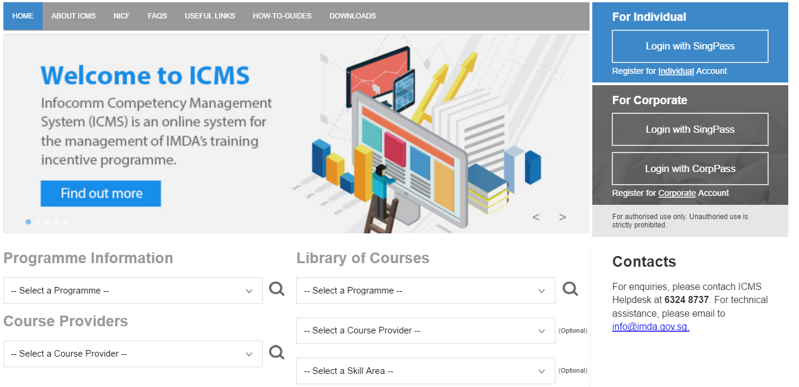
Access to ICMS - Login
ICMS Trainee Enrolment: Creation of Trainee Enrolment
Action: Click here to login using your SingPass or CorpPass Account
Note:
For Organisation, co-existence of SingPass or CorpPass login is available till end of Dec 2017. After which, CorpPass login is required.

Slide 8
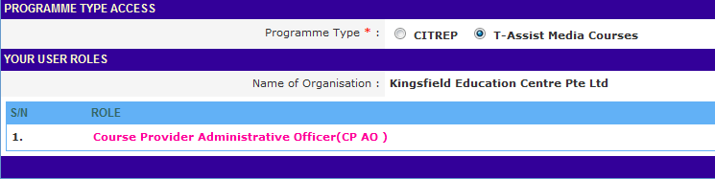
ICMS Trainee Enrolment: Creation of Trainee Enrolment
Programme Type/Role Selection:
Action:
Select CP AO Role

Slide 9
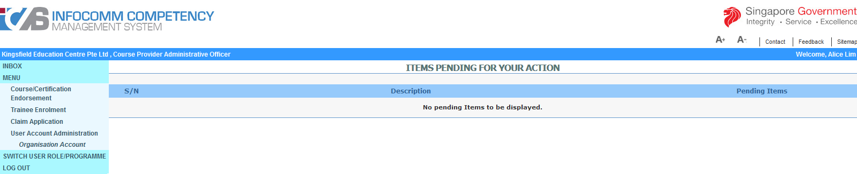
ICMS Trainee Enrolment: Creation of Trainee Enrolment
Create New Trainee Enrolment Record
Action:
Select ‘Trainee Enrolment’

Slide 10
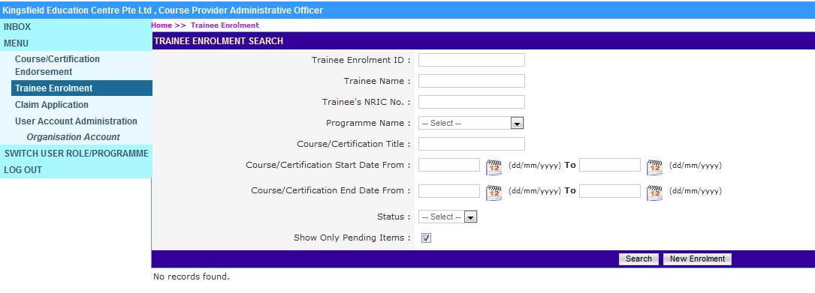
ICMS Trainee Enrolment: Creation of Trainee Enrolment
Create New Trainee Enrolment Record
Action:
Click on the New Enrolment button to create a new trainee enrolment record

Slide 11
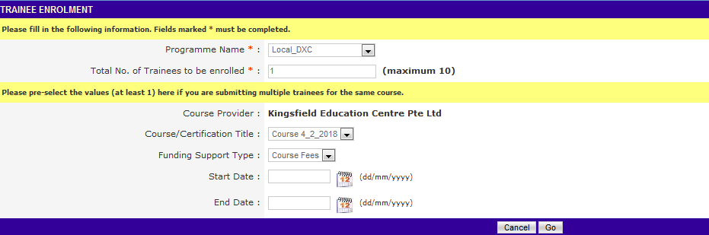
ICMS Trainee Enrolment: Creation of Trainee Enrolment
Create New Trainee Enrolment Record:
Common data fields such as Course/Certification Title, Start/End Date, etc. can be specified for bulk enrolments (up to 10 trainees)

Slide 12
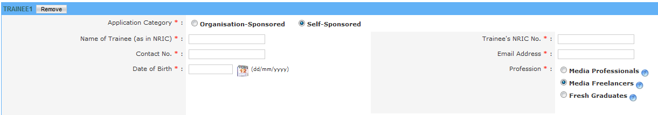
ICMS Trainee Enrolment: Creation of Trainee Enrolment
Profession selection
Action:
Select Profession type

Slide 13
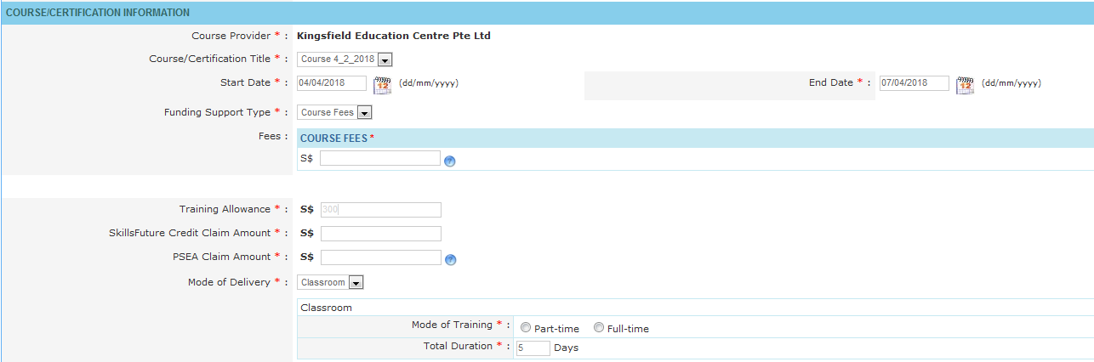
ICMS Trainee Enrolment: Creation of Trainee Enrolment
Submission of the SkillsFuture/PSEA Credit amount
Note: TrainingAllowance is readonly field. It is calculated by system based on the $7.50 x hours of training. It’s applicable for Local or Overseas Programme and visible in case Media Freelancers is selected.
Action:
To key in the SkillsFuture/PSEA Credit Claim amount used by eligible individual to offset the course fee

Slide 14
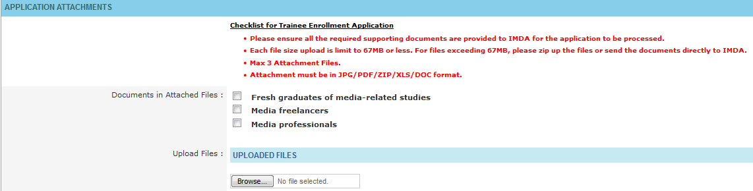
ICMS Trainee Enrolment: Creation of Trainee Enrolment
Uploading Function in ICMS:
Action:
Tick the documents that have been uploaded
Action:
Upload the necessary documents

Slide 15
ICMS Trainee Enrolment: Creation of Trainee Enrolment
Submission of Trainee Enrolment
Action: Select ‘Submit’ to submit trainee enrolment in system

Slide 16
ICMS Trainee Enrolment: Creation of Trainee Enrolment
Additional Information: Purpose of Buttons
Additional trainee will be added to the list
System will perform complete validation on the input
Discard all information provided and return to Trainee Enrolment Enquiry screen
System will perform minimum validate only (e.g. date format), and create one draft enrolment record

Slide 17
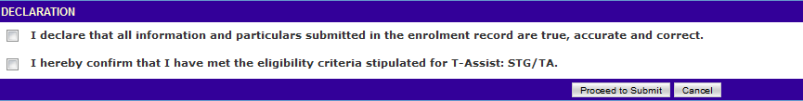
ICMS Trainee Enrolment: Creation of Trainee Enrolment
Submission of Declaration
Action: Complete the Declaration Section

Slide 18
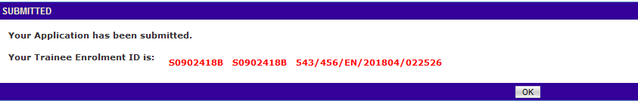
ICMS Trainee Enrolment: Creation of Trainee Enrolment
Successful Submission
If the Trainee Enrolment is submitted successfully, a Trainee Enrolment ID will be issued in the format of <Programme Code>/<Term Code>/EN/<YYYYMM>/<999999> for each trainee.

Slide 19
ICMS Trainee Enrolment: Update Trainee Enrolment
2.
Update Trainee Enrolment

Slide 20
Access to ICMS - Login
ICMS Trainee Enrolment: Update Trainee Enrolment
Action: Click here to login using your SingPass or CorpPass Account
Note:
For Organisation, co-existence of SingPass or CorpPass login is available till end of Dec 2017. After which, CorpPass login is required.

Slide 21
ICMS Trainee Enrolment: Update Trainee Enrolment
Programme Type/Role Selection:
Action:
Select CP AO Role

Slide 22
ICMS Trainee Enrolment: Update Trainee Enrolment
Update Trainee Enrolment
Action:
Select ‘Trainee Enrolment’

Slide 23
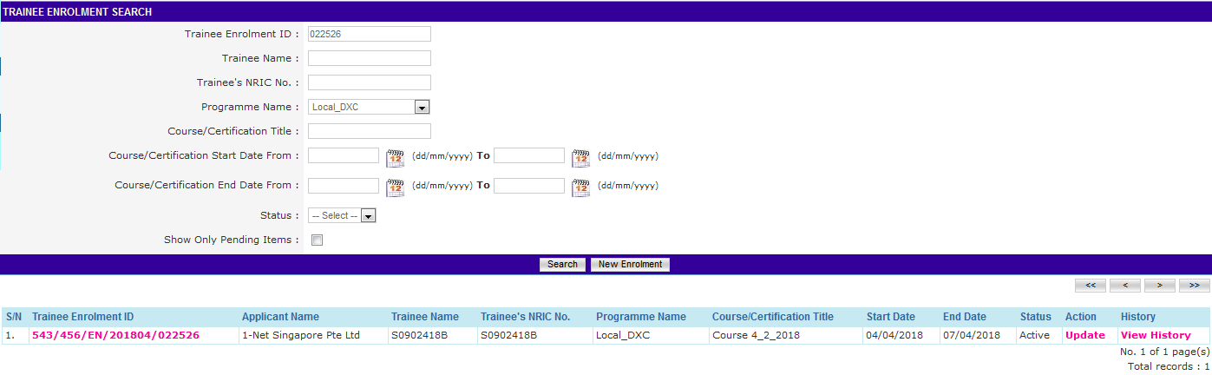
ICMS Trainee Enrolment: Update Trainee Enrolment
Update Trainee Enrolment
Action:
Fill in search criteria and select ‘Search’
Ensure ‘Show Only Pending Items’ check box is uncheck when searching

Slide 24
ICMS Trainee Enrolment: Update Trainee Enrolment
Update Trainee Enrolment
Action: Select ‘Update’

Slide 25
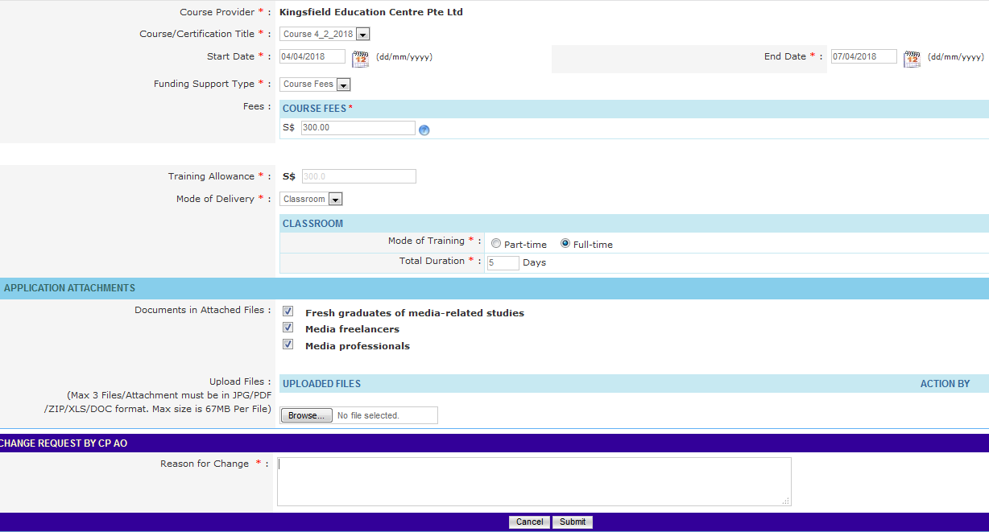
ICMS Trainee Enrolment: Update Trainee Enrolment
Update Trainee Enrolment
Action: Fill in reason and Click ‘Submit’

Slide 26
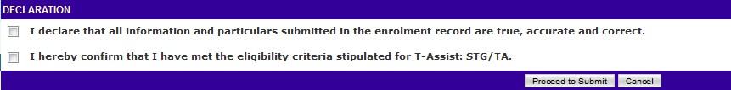
ICMS Trainee Enrolment: Update Trainee Enrolment
Submission of Declaration
Action: Complete the Declaration Section

Slide 27
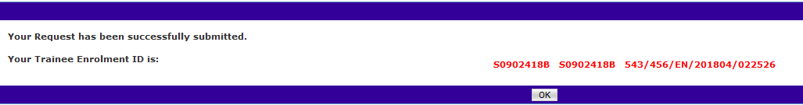
ICMS Trainee Enrolment: Update Trainee Enrolment
Successful Submission
System display the Trainee Enrollment ID generated successfully.

Slide 28
ICMS Trainee Enrolment: Search/View Trainee Enrolment
3.
Search/View Trainee Enrolment

Slide 29
Access to ICMS - Login
ICMS Trainee Enrolment: Search/View Trainee Enrolment
Action: Click here to login using your SingPass or CorpPass Account
Note:
For Organisation, co-existence of SingPass or CorpPass login is available till end of Dec 2017. After which, CorpPass login is required.

Slide 30
ICMS Trainee Enrolment: Search/View Trainee Enrolment
Programme Type/Role Selection:
Action:
Select CP AO Role

Slide 31
ICMS Trainee Enrolment: Search/View Trainee Enrolment
Search Trainee Enrolment
Action:
Select ‘Trainee Enrolment’

Slide 32
ICMS Trainee Enrolment: Search/View Trainee Enrolment
Search Trainee Enrolment
Action:
Fill in search criteria and select ‘Search’
Ensure ‘Show Only Pending Items’ check box is uncheck when searching

Slide 33
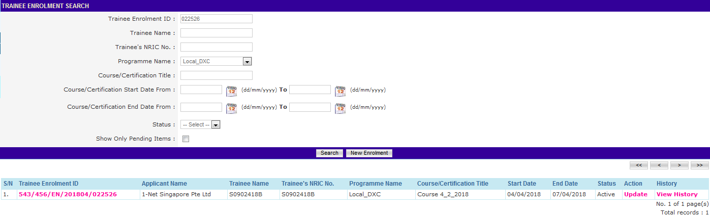
ICMS Trainee Enrolment: Search/View Trainee Enrolment
Search Trainee Enrolment
Action:
Select Hyperlink of Trainee Enrolment ID

Slide 34
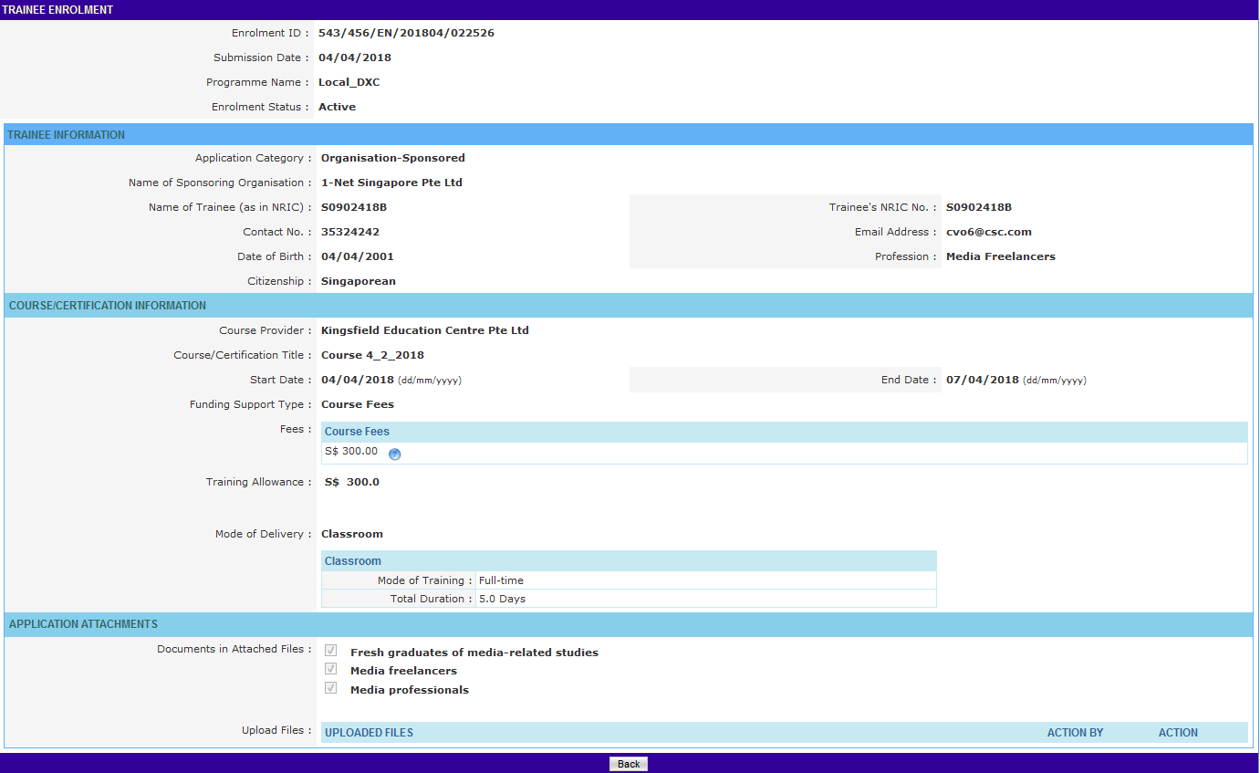
ICMS Trainee Enrolment: Search/View Trainee Enrolment
Trainee Enrolment Application
Action: Select ‘Back’ to return search page

