Slide 1



ICMS User Orientation Training
Infocomm Competency Management System (ICMS)
SECTION D: TRAINEE ENROLMENT
For Individuals & Sponsoring Organisations
April 2018

Slide 2
ICMS Trainee Enrolment: Content Page
Individuals and Sponsoring Organisations (SO) are able to perform the following functions in ICMS:
    Update Trainee Enrolment Record Details
    Search/View Trainee Enrolment Record

Slide 3
Individuals
1. Update Trainee Enrolment Record Details
2. Search/View Trainee Enrolment Record

Slide 4
ICMS Trainee Enrolment: Update Trainee Enrolment
1.
Update Trainee Enrolment

Slide 5
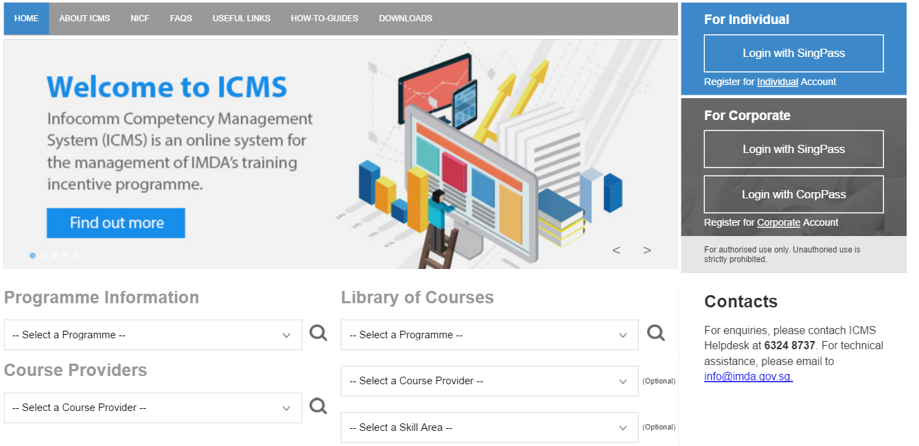
Access to ICMS - Login using Singpass
ICMS Trainee Enrolment: Update Trainee Enrolment
Action: Click here to login using your SingPass

Slide 6
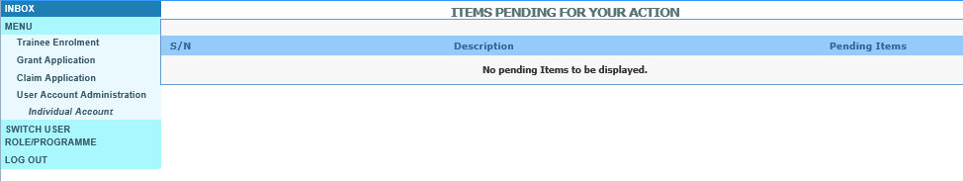
ICMS Trainee Enrolment: Update Trainee Enrolment
Update Trainee Enrolment
Action:
Select ‘Trainee Enrolment’

Slide 7
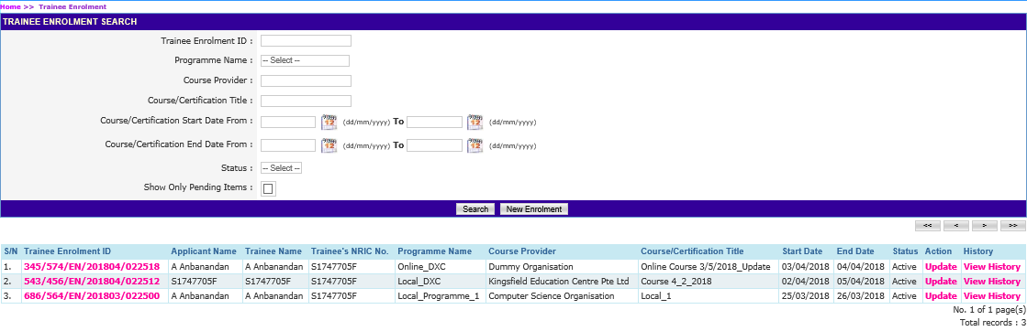
ICMS Trainee Enrolment: Update Trainee Enrolment
Update Trainee Enrolment
Action:
Fill in search criteria and click ‘Search’
Ensure ‘Show Only Pending Items’ check box is uncheck when searching

Slide 8
ICMS Trainee Enrolment: Update Trainee Enrolment
Update Trainee Enrolment
Action: Click ‘Update’

Slide 9
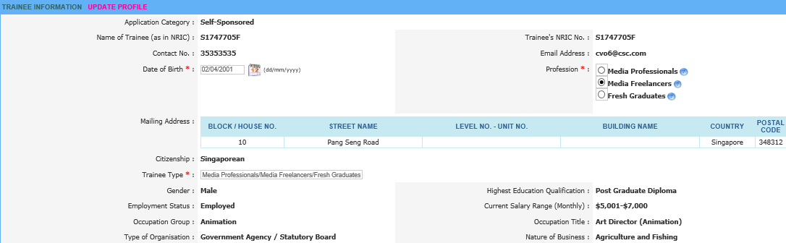
ICMS Trainee Enrolment: Update Trainee Enrolment
Trainee Enrolment Details
Action: Fill in the form
Trainee Type* :

Slide 10
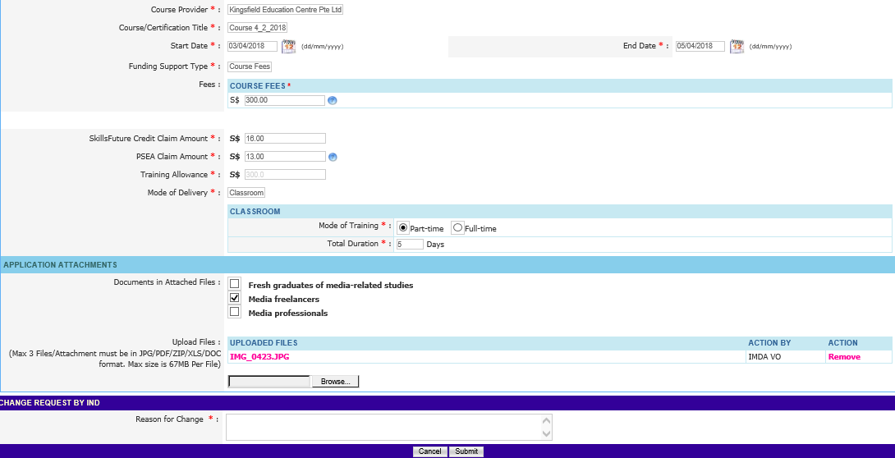
ICMS Trainee Enrolment: Update Trainee Enrolment
Local Media Course – Trainee Enrolment Details
Action: Indicate the reason for change request or updating of Trainee Enrolment record and select ‘Submit’
Action: You may upload the required documents if necessary.

Slide 11
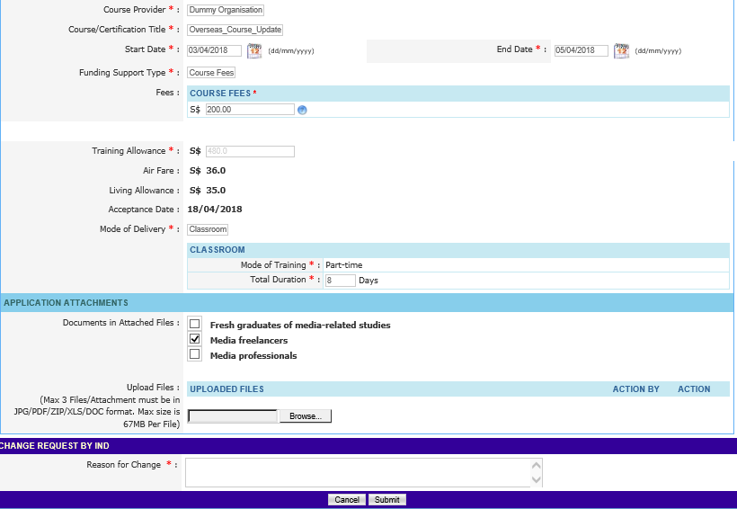
ICMS Trainee Enrolment: Update Trainee Enrolment
Overseas Media Course – Trainee Enrolment Details
Action: Upload supporting document
Action: Fill in reason and Click‘Submit’

Slide 12
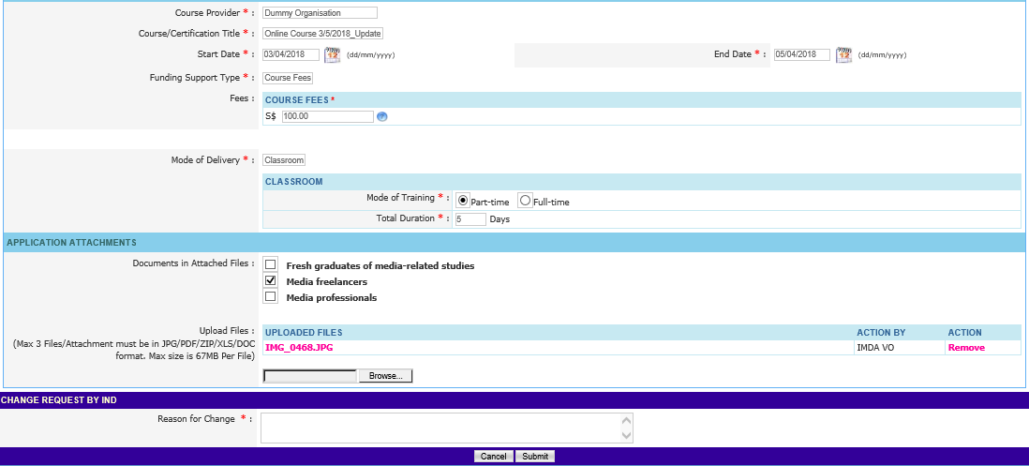
ICMS Trainee Enrolment: Update Trainee Enrolment
Online Media Course – Trainee Enrolment Details
Action: Indicate the reason for change request or updating of Trainee Enrolment record and select ‘Submit’
Action: You may upload the required documents if necessary.

Slide 13

ICMS Trainee Enrolment: Update Trainee Enrolment
Submission of Declaration
Action: Complete the Declaration Section

Slide 14

ICMS Trainee Enrolment: Update Trainee Enrolment
Successful Submission
System display Trainee Enrollment ID generated successfully.

Slide 15
ICMS Trainee Enrolment: Search/View Trainee Enrolment
2.
Search/View Trainee Enrolment

Slide 16
Access to ICMS - Login using Singpass
ICMS Trainee Enrolment: Search/View Trainee Enrolment
Action: Click here to login using your SingPass

Slide 17
ICMS Trainee Enrolment: Search/View Trainee Enrolment
Search/View Trainee Enrolment
Action:
Select ‘Trainee Enrolment’

Slide 18
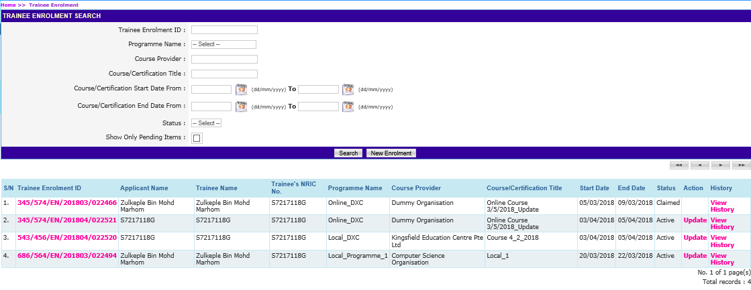
ICMS Trainee Enrolment: Search/View Trainee Enrolment
Search Trainee Enrolment
Action:
Fill in search criteria and select ‘Search’
Ensure ‘Show Only Pending Items’ check box is uncheck when searching

Slide 19
ICMS Trainee Enrolment: Search/View Trainee Enrolment
View Trainee Enrolment
Action:
Select Hyperlink of Trainee Enrolment ID

Slide 20
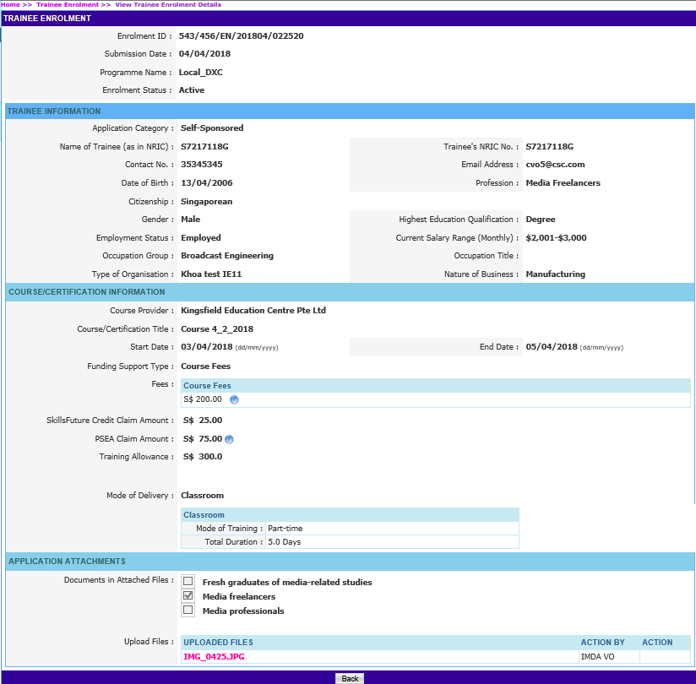
ICMS Trainee Enrolment: Search/View Trainee Enrolment
Local Media Course - Trainee Enrolment Application
Action: Select ‘Back’ to return search page

Slide 21
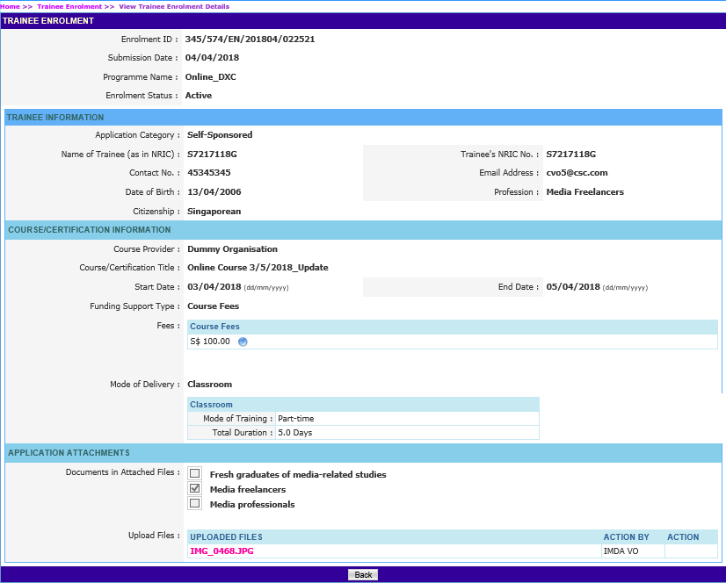
ICMS Trainee Enrolment: Search/View Trainee Enrolment
Online Media Course - Trainee Enrolment Application
Action: Select ‘Back’ to return search page

Slide 22
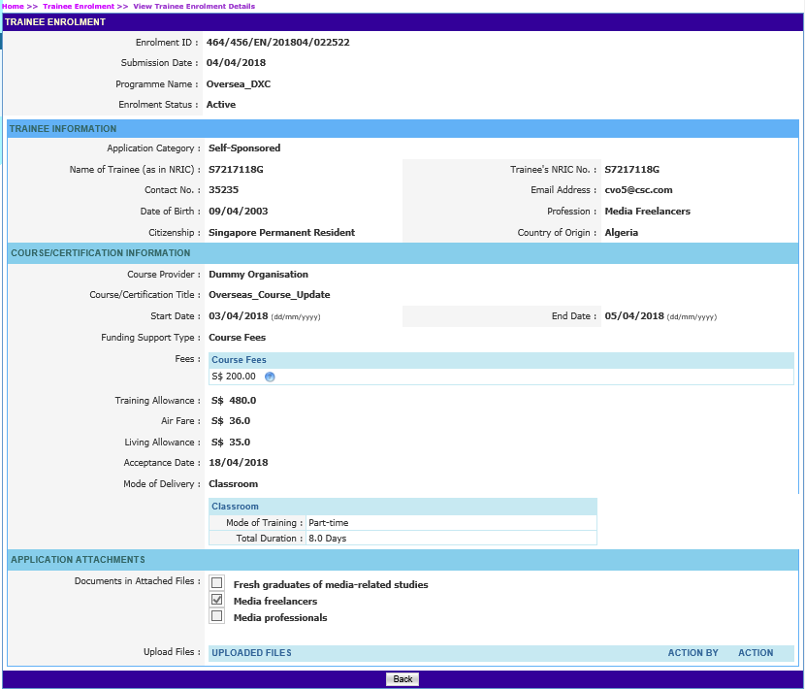
ICMS Trainee Enrolment: Search/View Trainee Enrolment
Overseas Media Course - Trainee Enrolment Application
Action: Select ‘Back’ to return search page

Slide 23
Sponsoring Organisations
1. Update Trainee Enrolment Record Details
2. Search/View Trainee Enrolment Record
SO AO Submission of Update

Slide 24
ICMS Trainee Enrolment: Update Trainee Enrolment
1.
Update Trainee Enrolment

Slide 25
Access to ICMS - Login
ICMS Trainee Enrolment: Update Trainee Enrolment
Action: Click here to login using your SingPass or CorpPass Account
Note:
For Organisation, co-existence of SingPass or CorpPass login is available till end of Dec 2017. After which, CorpPass login is required.

Slide 26
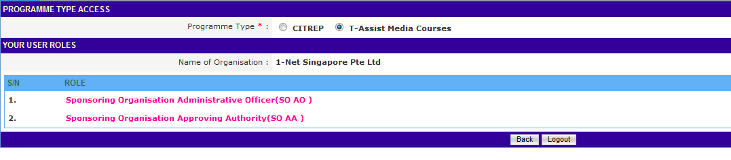
ICMS Trainee Enrolment: Update Trainee Enrolment
Programme Type/User role selection
Action:
Select SO AO Role

Slide 27
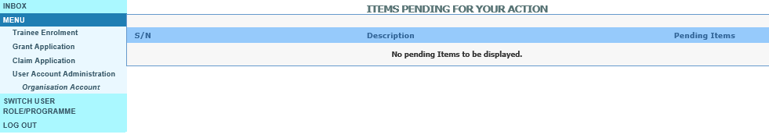
ICMS Trainee Enrolment: Update Trainee Enrolment
Update Trainee Enrolment
Action:
Select ‘Trainee Enrolment’

Slide 28
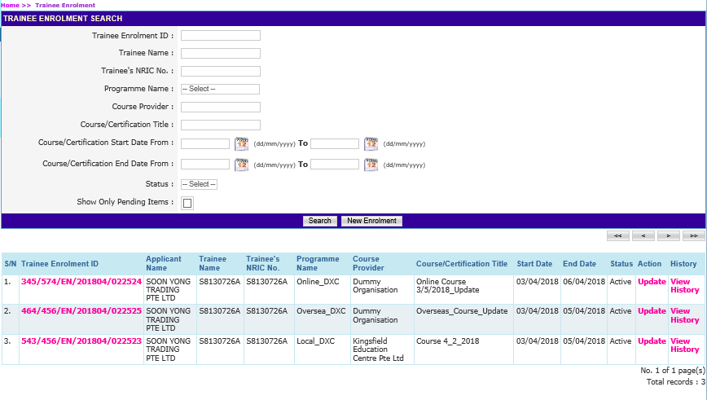
ICMS Trainee Enrolment: Update Trainee Enrolment
Update Trainee Enrolment
Action:
Key in relevant information and select ‘Search’ *Ensure ‘Show Only Pending Items’ check box is uncheck when searching

Slide 29
ICMS Trainee Enrolment: Update Trainee Enrolment
Update Trainee Enrolment
Action: Select ‘Update’

Slide 30
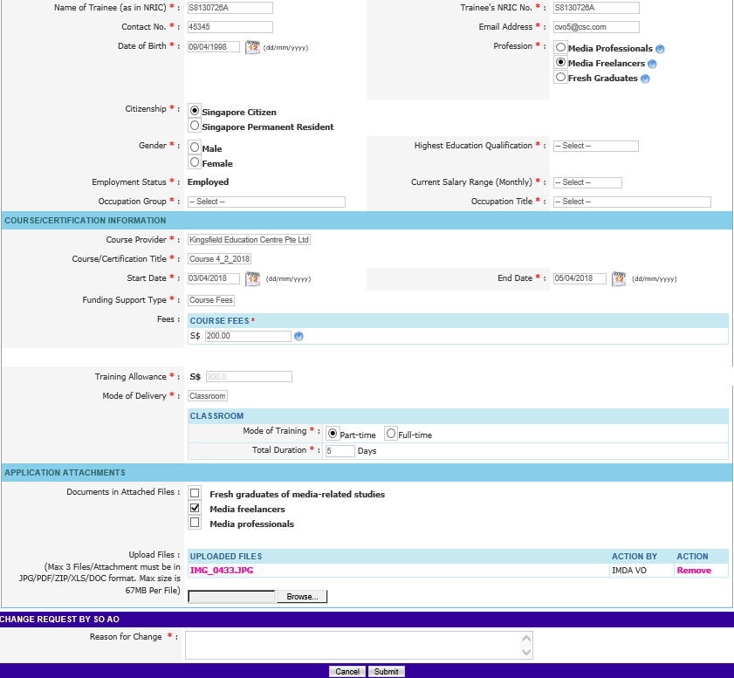
ICMS Trainee Enrolment: Update Trainee Enrolment
Local Media Course – Trainee Enrolment Details
Action: Fill in reason and select ‘Submit’

Slide 31
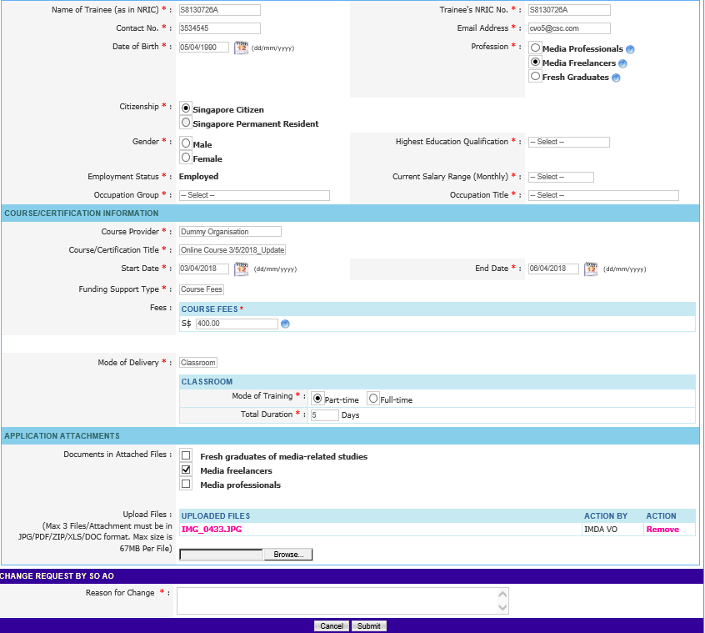
ICMS Trainee Enrolment: Update Trainee Enrolment
Online Media Course – Trainee Enrolment Details
Action: Fill in reason and select ‘Submit’

Slide 32
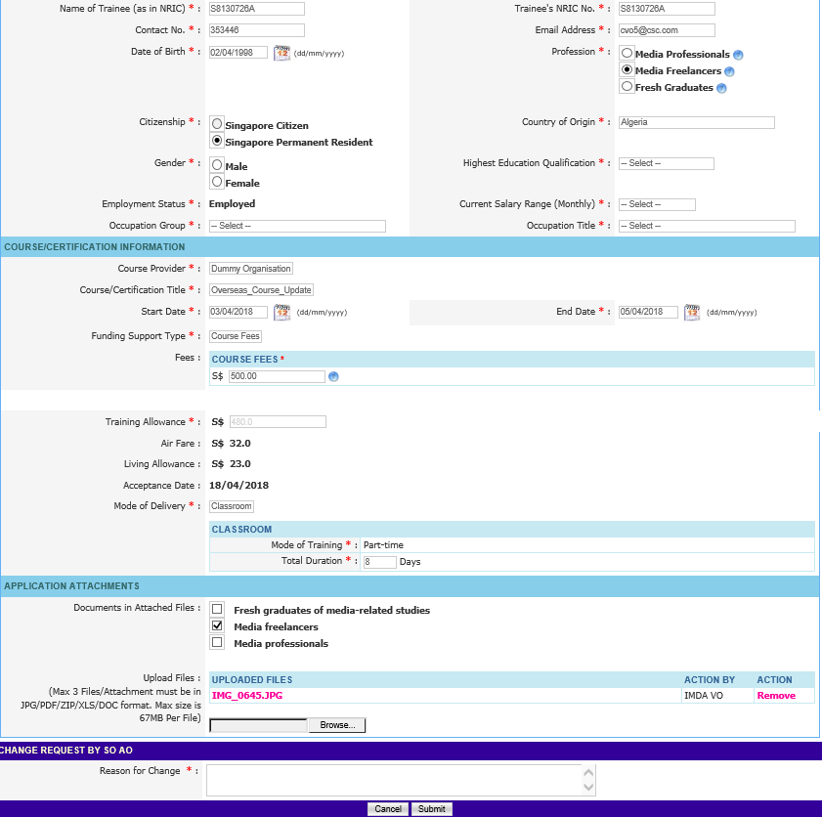
ICMS Trainee Enrolment: Update Trainee Enrolment
Overseas Media Course – Trainee Enrolment Details
Action: Fill in reason and select ‘Submit’

Slide 33
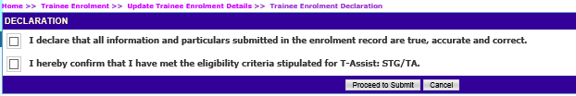
ICMS Trainee Enrolment: Update Trainee Enrolment
Submission of Declaration
Action: Complete the Declaration Section

Slide 34
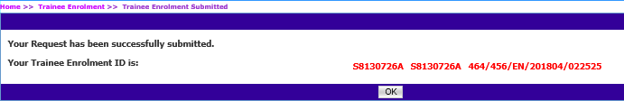
ICMS Trainee Enrolment: Update Trainee Enrolment
Successful Submission
System displays the Trainee Enrollment ID generated successfully.

Slide 35
ICMS Trainee Enrolment: Search/View Trainee Enrolment
2.
Search/View Trainee Enrolment

Slide 36
Access to ICMS - Login
ICMS Trainee Enrolment: Search/View Trainee Enrolment
Action: Click here to login using your SingPass or CorpPass Account
Note:
For Organisation, co-existence of SingPass or CorpPass login is available till end of Dec 2017. After which, CorpPass login is required.

Slide 37
ICMS Trainee Enrolment: Search/View Trainee Enrolment
Programme Type/User role selection
Action:
Select SO AO Role

Slide 38
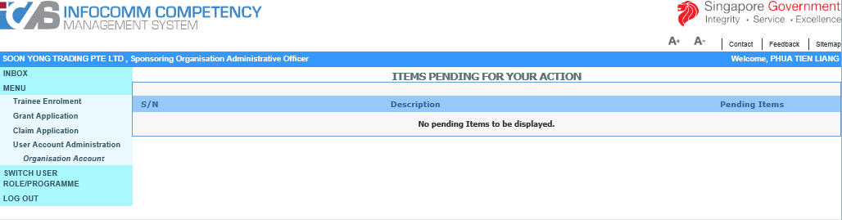
ICMS Trainee Enrolment: Search/View Trainee Enrolment
Search/View Trainee Enrolment
Action:
Select ‘Trainee Enrolment’

Slide 39
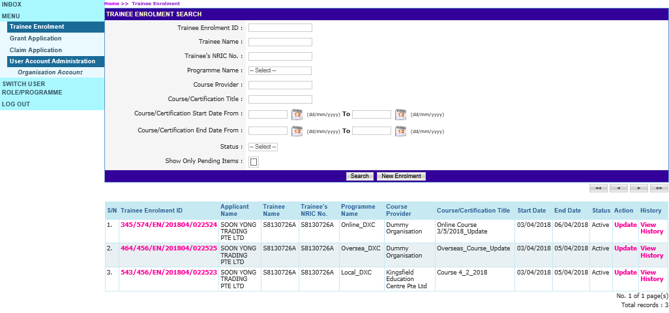
ICMS Trainee Enrolment: Search/View Trainee Enrolment
Search Trainee Enrolment
Action:
Key in search criteria and click ‘Search’
Ensure ‘Show Only Pending Items’ check box is uncheck when searching

Slide 40
ICMS Trainee Enrolment: Search/View Trainee Enrolment
View Trainee Enrolment
Action:
Click Hyperlink of Trainee Enrolment ID

Slide 41
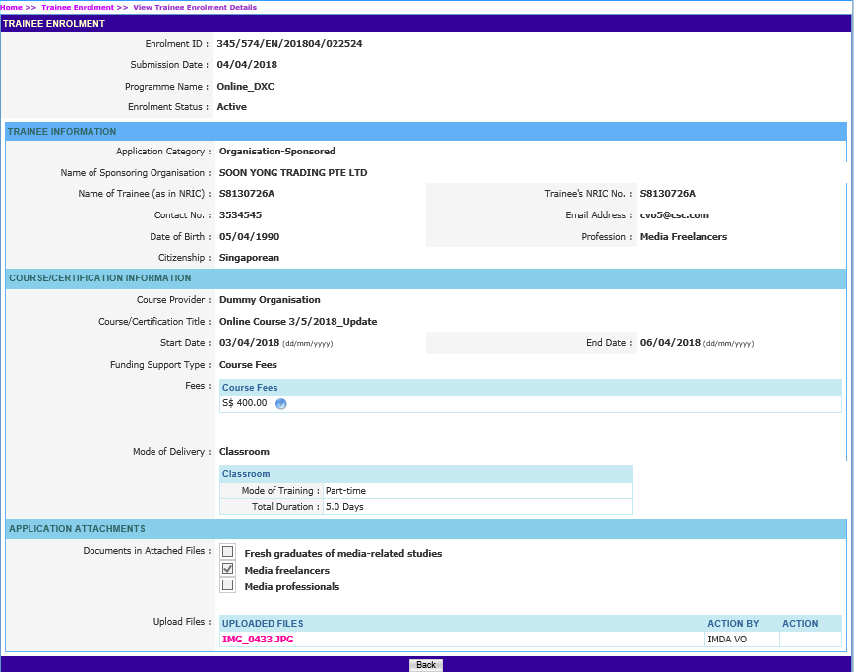
ICMS Trainee Enrolment: Search/View Trainee Enrolment
Online Media Course - Trainee Enrolment Application
Action: Click ‘Back’ to return search page

Slide 42
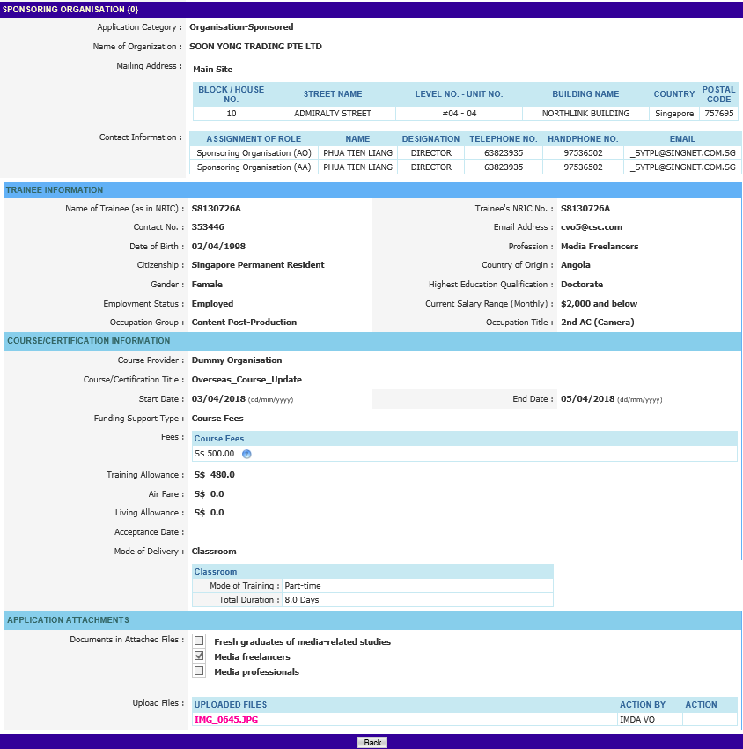
ICMS Trainee Enrolment: Search/View Trainee Enrolment
Overseas Media Course - Trainee Enrolment Application
Action: Click ‘Back’ to return search page

Slide 43
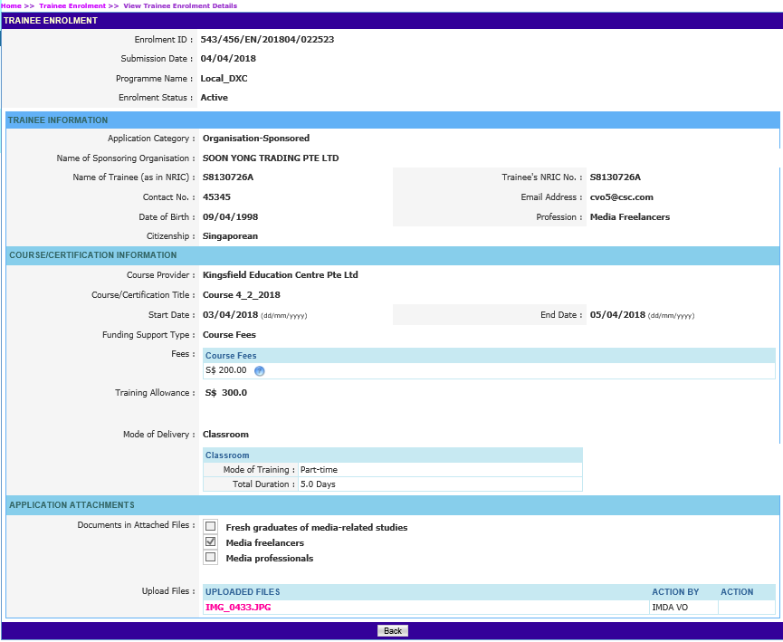
ICMS Trainee Enrolment: Search/View Trainee Enrolment
Local Media Course - Trainee Enrolment Application
Action: Click ‘Back’ to return search page

